Slide 1

CSE- 458
VLSI Design Lab

Slide 2
VLSI
VLSI is an acronym for Very Large Scale Integration.
VLSI is the process of creating an integrated circuit (IC) by combining thousands of transistors into a single chip.
Language used for designing VLSI circuit
VHDL
Verilog

Slide 3
VHDL and Verilog
VHDL | Verilog
Not Case Sensitive | Case sensitive
Based on Pascal | Based on C
Difficult to learn | Easy to learn

Slide 4
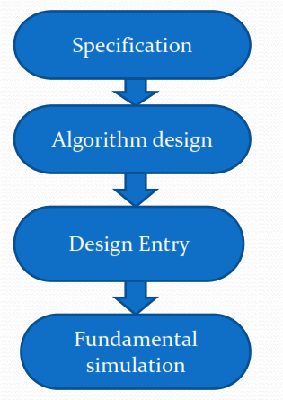
VLSI Design Hierarchy

Slide 5
CAD Tools
Why Do We Need CAD Tools ?
Design a very complex system.
Design abstraction and decomposition is done to manage complexity.
Tools automate the process of converting your design from one abstraction level to another.
Design Automation Tools improve productivity.
Different tools are required in different steps.

Slide 6
CAD Tools for VLSI
Popular CAD tools for VLSI
Xcircuit
Ktechlab
Gnucap
qucs (Quite Universal Circuit Simulator)
Verilator
Cadence
Microwind

Slide 7
Microwind
Microwind software allows the designer to simulate and design an integrated circuit at physical description level.
The microwind software has following segments in it:
DSCH
nanoLambda
VirtuosoFab
PROthumb
PROtutor
MEMsim

Slide 8
DSCH
DSCH program is a logic editor and simulator.
DSCH is used to validate the architecture of the logic circuit before the microelectronics design is started.
DSCH provides a user-friendly environment for hierarchical logic design, and fast simulation with delay analysis, which allows the design and validation of complex logic structures.

Slide 9
Inverter ??

Slide 10
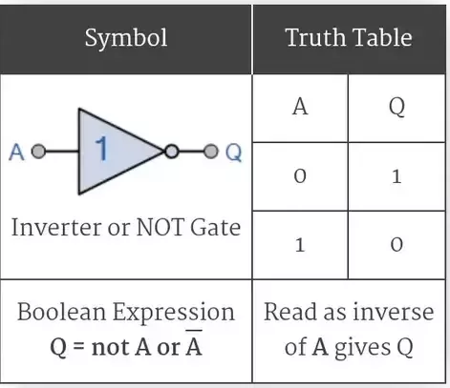
Inverter Design

Slide 11
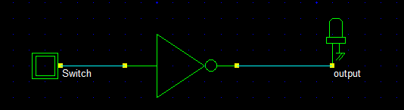
Inverter Design using DSCH

Slide 12
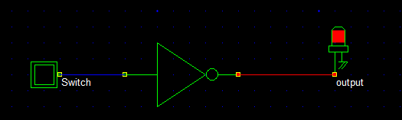
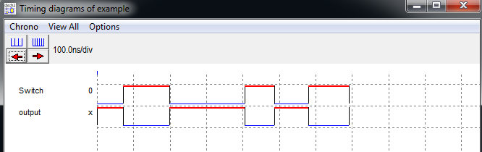
Inverter Design using DSCH

Slide 13
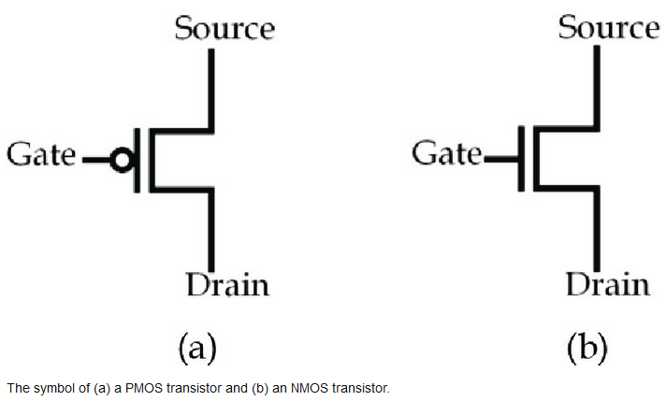
Inverter Design using CMOS

Slide 14
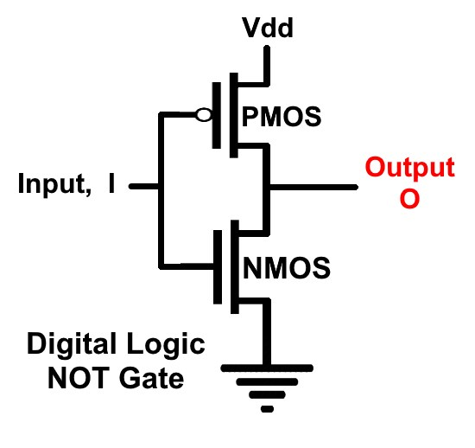
Inverter Design using CMOS

Slide 15
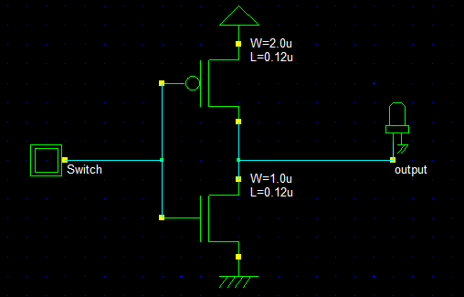
Inverter Design using CMOS

Slide 16
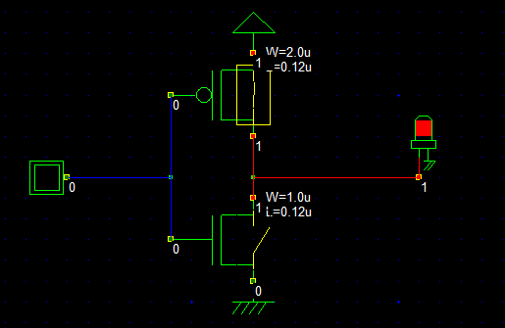
Inverter Design using CMOS

Slide 17
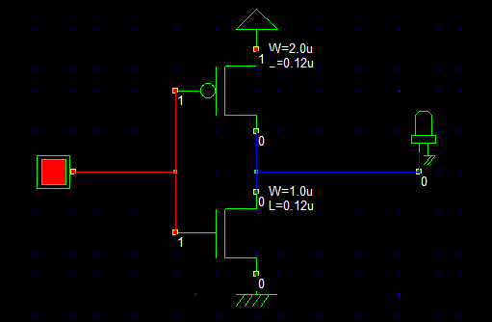
Inverter Design using CMOS

Slide 18
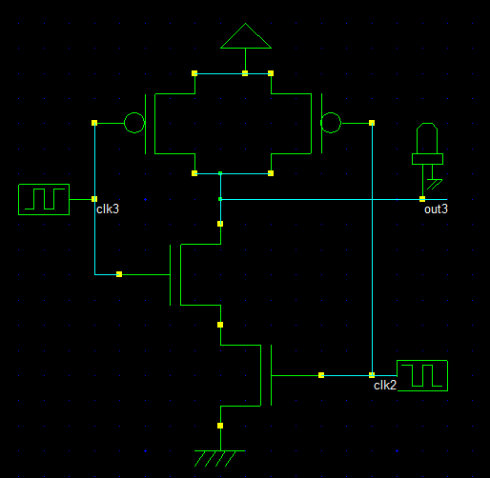
NAND Design using CMOS

Slide 20
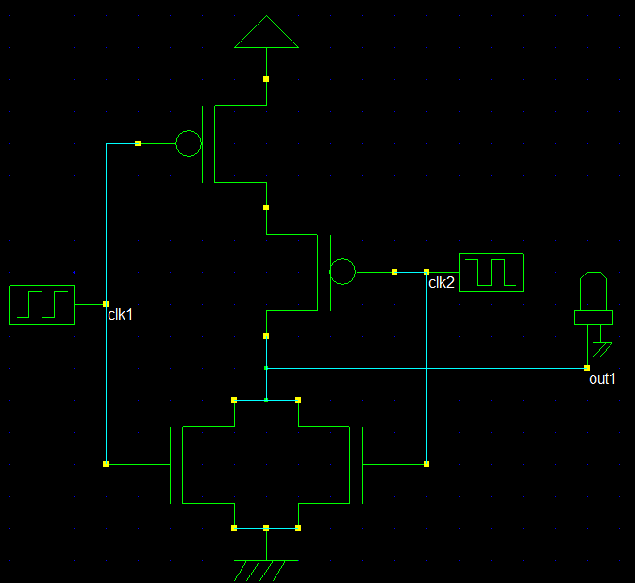
NOR Design using CMOS

Slide 22
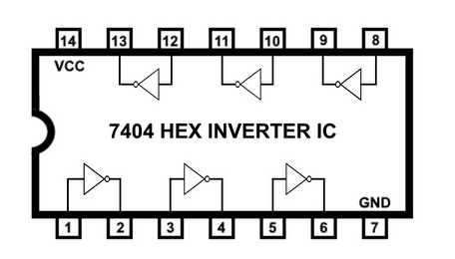
7404 Hex Inverter IC

Slide 23

Thanks to All

